Slide 1
Ronald Reagan Orchestra Booster Club General Meeting
May 10th, 2021
6:30-7:00PM

Slide 2
ROBC Mission
The Reagan Orchestra Booster Club is a registered nonprofit organization comprised of Orchestra Directors and parent volunteers dedicated to the promotion of the nationally recognized and award-winning Ronald Reagan High School Orchestra.
The ROBC assists in funding the education, performances, and activities of the Reagan High School Orchestra as well as supporting special events, orchestra clinics, and community outreach.

Slide 3
Your ROBC Volunteers:
Board Members:
President - Nathan Shapiro
Vice President – Kristen Roach
Treasurer - John Horton
Secretary – Daniella Decanini
Publicity - Tara Ford
Bookkeeper - Angela Halsell
Chairs:
Meal & Snack Chair - Denise Trevino
Banquet - Thalia Sanchez-Kiolbassa
Uniform Chair - Gabriela De la Fuente
Scholarship - Dana Comstock

Slide 4
Treasurer’s Report
Current Balance: $20,774 as of 5/7/2021
2020-2021 donations to date: $5829
Top Spend ($4900) was for;
Virtual classroom support
Performance and Interaction
Equipment & Technology
Software
Clinicians/Technical Assistance
Positive Cash Flow:
Total In: $18,138
Total Spent: $12,404
Net Inflow: $5734

Slide 5
Fundraising
Fundraising in 2020-2021 school year;
Just over $2,600
Top sources;
Spirit nights
Wash Tub, Sock sales and one corporate sponsor

Slide 6
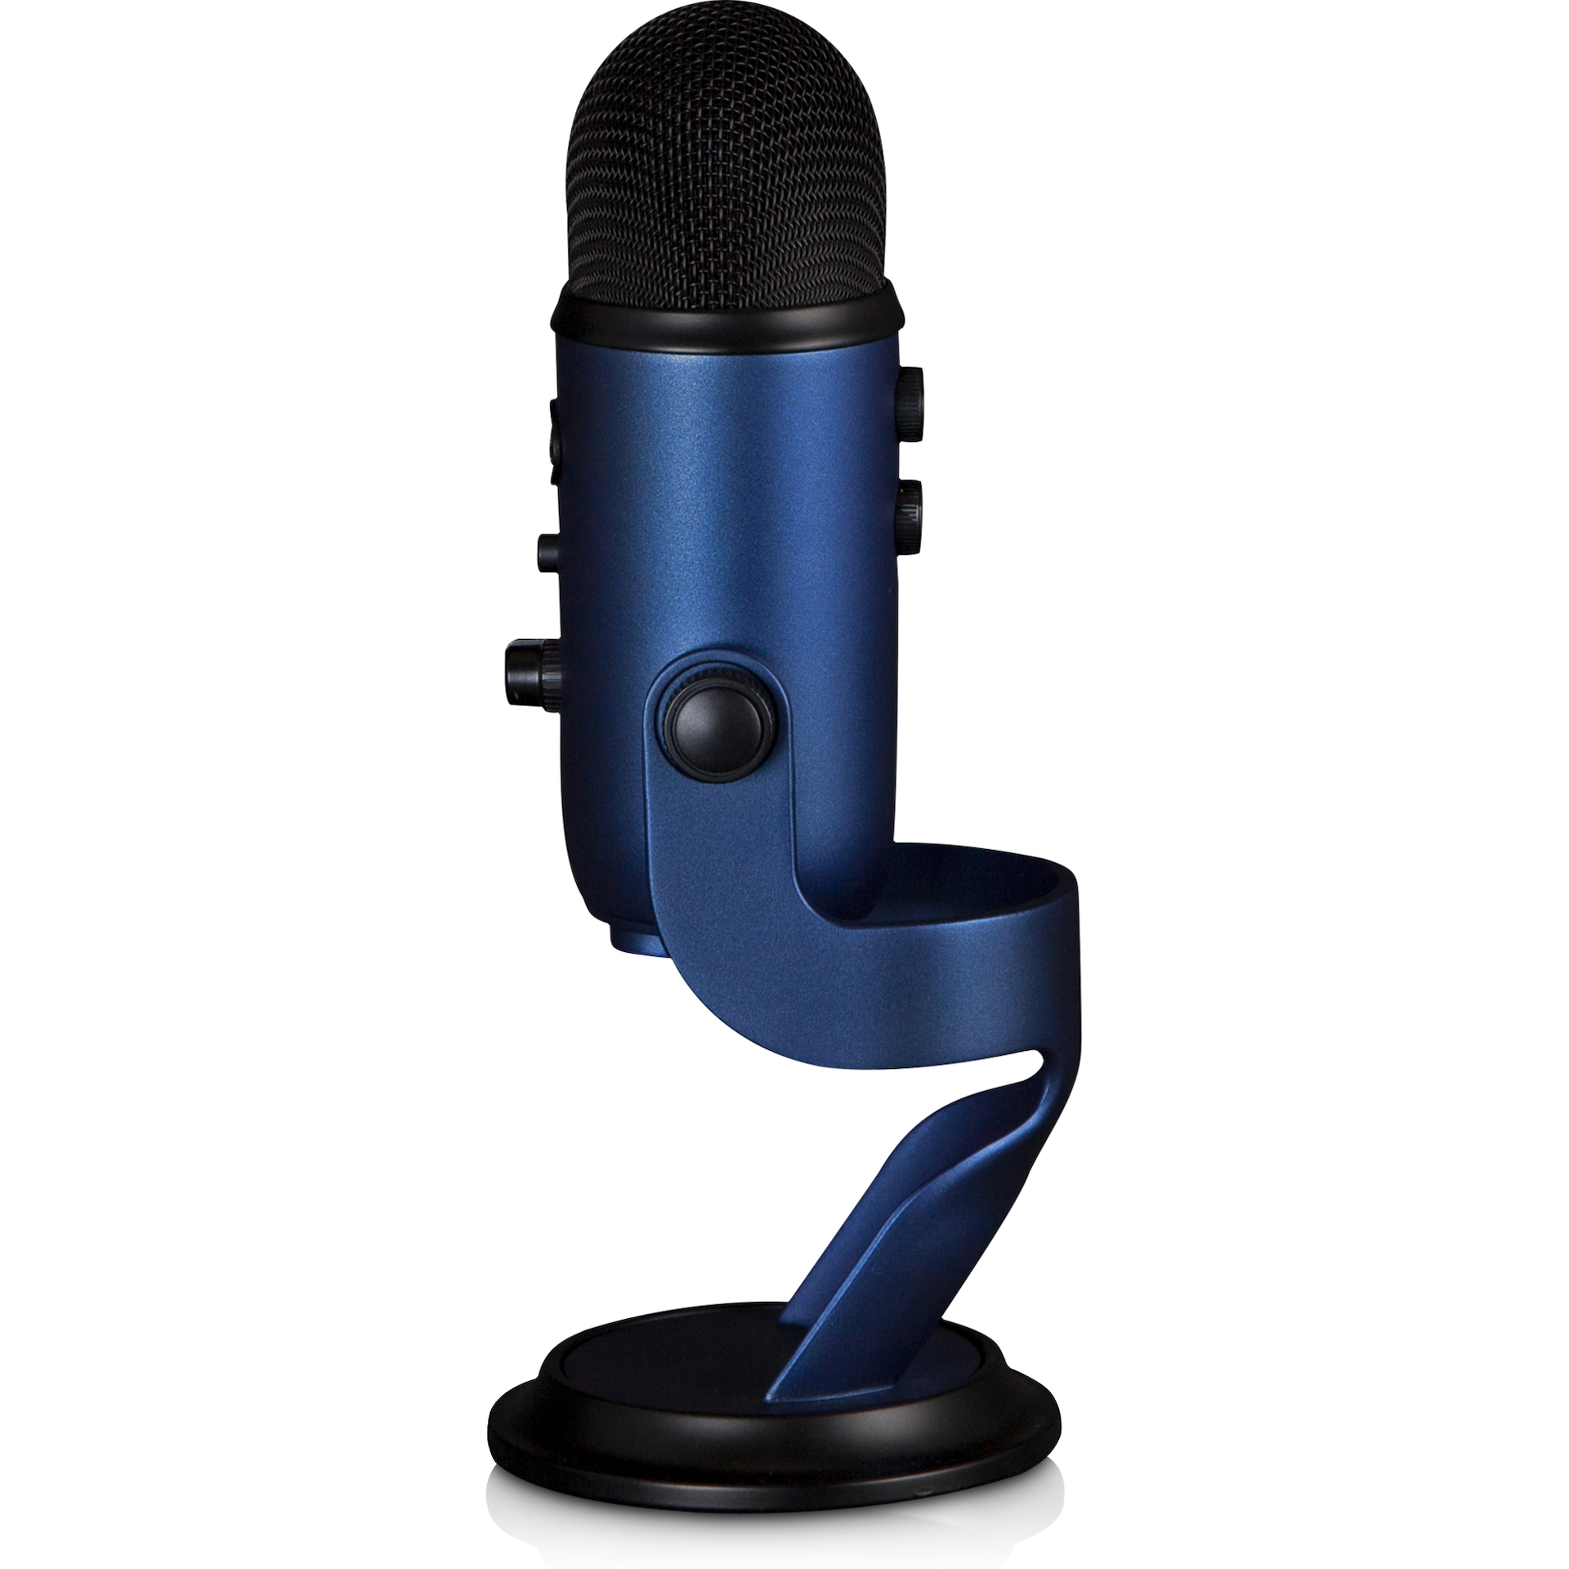
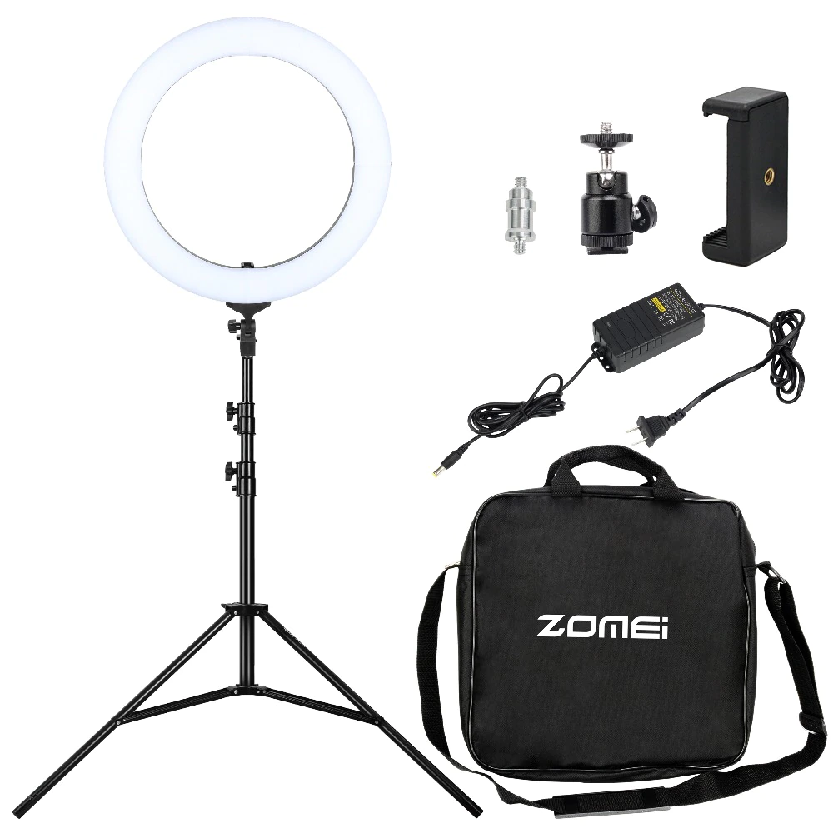
Where did your money go?
2 Blue Yeti Microphones
18” Ring Lights

Slide 7
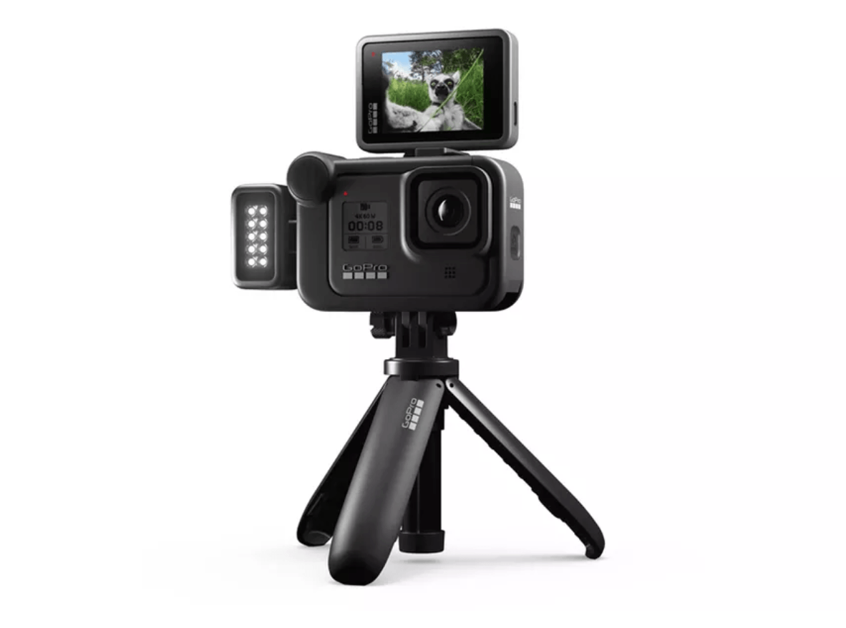
Where did your money go?
Go Pro Hero 8
Other Items:
Stand for donated large scree TV
Virtual events and clinicians
Software for virtual instruction
Year end event

Slide 8
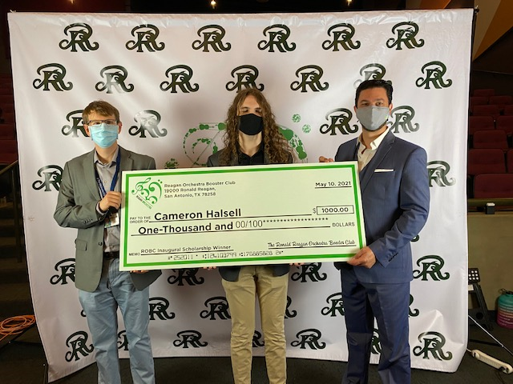
Where did your money go?
Inaugural Scholarship Fund

Slide 9
How we communicate:
Reagan Orchestra Website: http://reaganorchestra.weebly.com/
Charms: Please make sure your email is updated
General meetings before all regular concerts

Slide 10
Volunteers needed:
Uniform Chair position needed for next school year

Slide 11
How to Contact Nate Shapiro:
Phone: 210-278-8286
Email: ROBCPresident@Gmail.com

